Slide 1
ENGINEERING ECONOMY
Factors and their Use

Slide 2
The concept of equivalence
Alternatives should be compared as far as possible when they produce similar results, serve the same purpose, or accomplish the same function.
This is not always possible in some types of economy studies.
The question is how can alternatives for providing the same service or accomplishing the same function be compared when interest is involved over an extended period of time?

Slide 3

N-1
N

Slide 4
Single-Payment Factors
(F/P and P/F)
If we have P cedis at the present time and invest it at an interest rate of i, the future value F in 1 year will be
  F₁ = P + Pi
  F₁ = P (1 + i)
After two years it will be
  F₂ = F₁ + F₁i
  = P (1 + i) + P (1 + i)i
  = P (1 + i)²

Slide 5
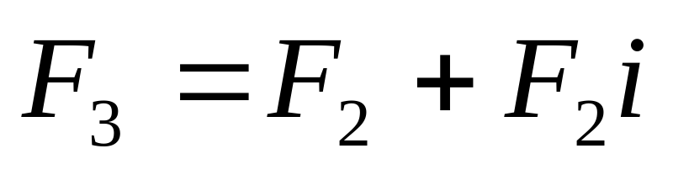
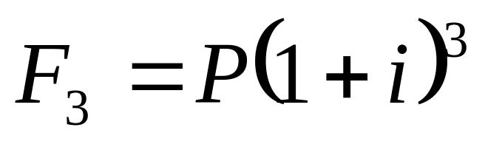
F/P factor
Similarly, the amount of money accumulated at the end of year three, using will be
Substituting P (1 + i)² for F₂ and simplifying,

Slide 6
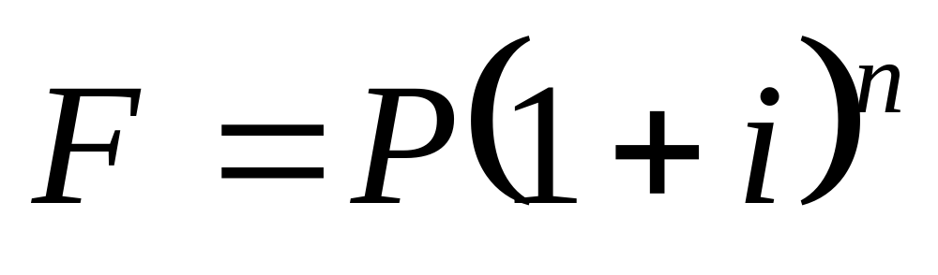
F/P factor
From the preceding values, it is evident by mathematical induction that the formula can be generalized for n years to

Slide 7
F/P factor
The factor
(1 + i)^{n}
is called
the single payment compound amount factor (SPCAF)
but it is usually referred to as F/P factor.

Slide 8
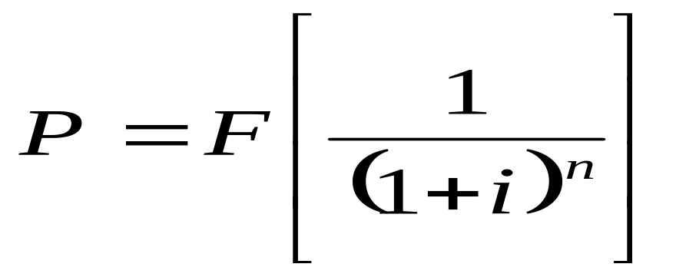
P/F factor
Solving for P in the last equation in terms of F results in the expression

Slide 9
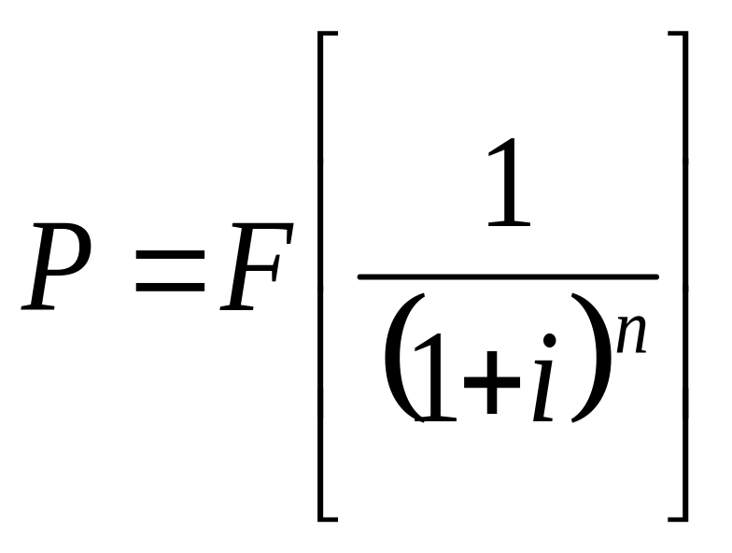
P/F factor
The expression in the brackets is known as the
single payment present-worth factor (SPPWF),
or the P/F factor

Slide 10
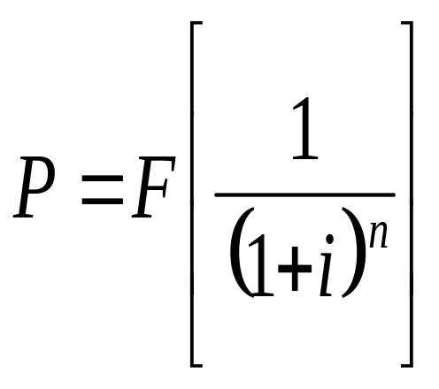
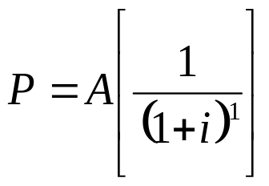
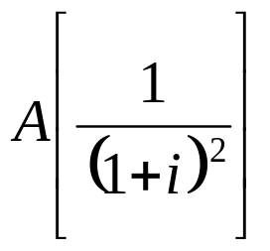
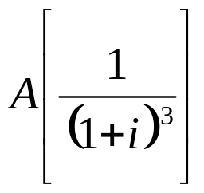
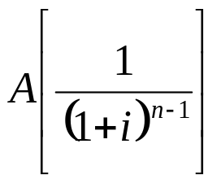
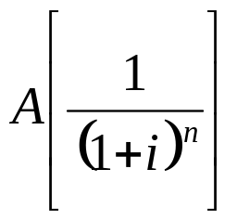
Uniform series
The present worth P of a uniform series can be determined by considering each A as a future worth F and using the equation with the P/F factor and then summing the present-worth values. The general formula is
+
+
+
+....

Slide 11
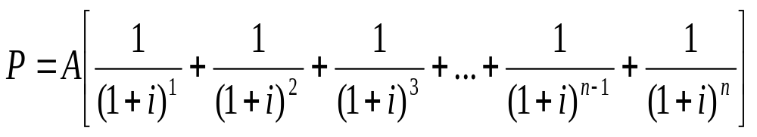
Uniform series
where the terms in brackets represent the P/F factors for years 1 through n respectively. Factoring out A, (eq.4)

Slide 12
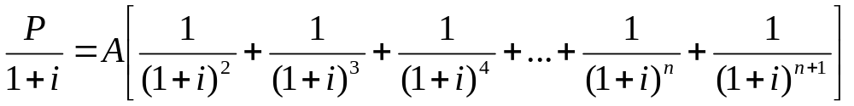
Uniform series
The equation 4 may be simplified by multiplying both sides of the equation by the (P/F,i%,1) factor which is 1/(1 + i)
(Eq. 5)

Slide 13
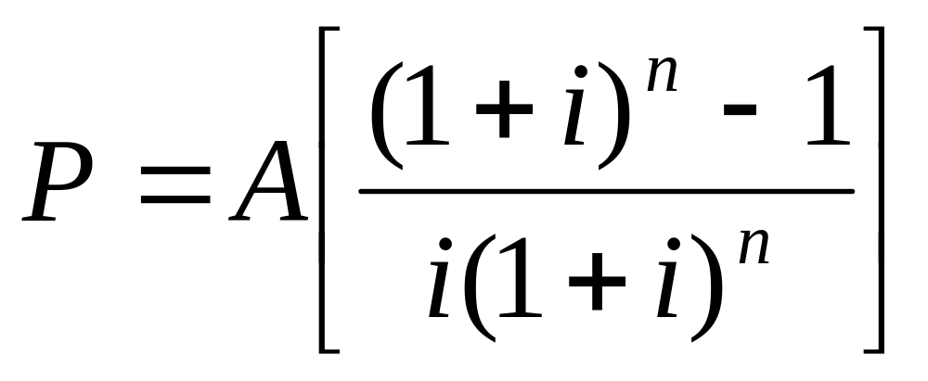
Uniform series
Subtracting equation 4 from equation 5, simplifying, to obtain the expression for P when i ≠ 0
and then dividing both sides of the relation by -i/(1 + i) leads to an expression for P when i ≠ 0

Slide 14
Uniform-series
The term in brackets is called the Uniform-series present-worth factor (USPWF), or P/A factor.
This equation will give the present worth P of an equivalent uniform annual series A which begins at the end of year 1 and extends for n years at an interest rate i.

Slide 15
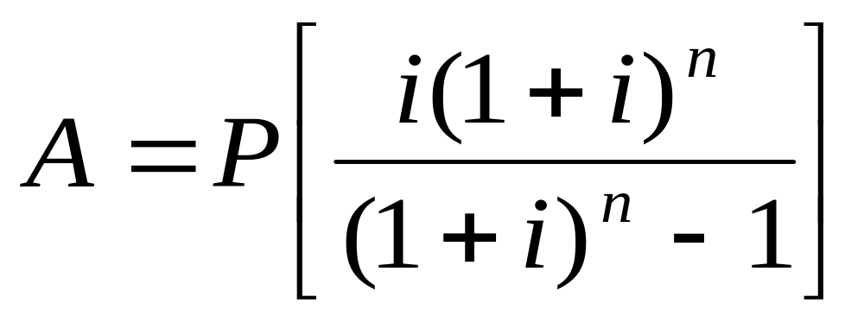
Uniform Series
Rearranging the P/A factor we get the Capital Recovery Factor (CRF) or the A/P factor
This yields the equivalent uniform annual worth A over n years of a given investment P when the interest rate is i.

Slide 16
P/A and A/P FACTORS
It is very important to remember that these formulas are derived with the present worth P and the first uniform annual amount (A) one year (period) apart.
That is the present worth P must always be located one period prior to the first A.

Slide 17
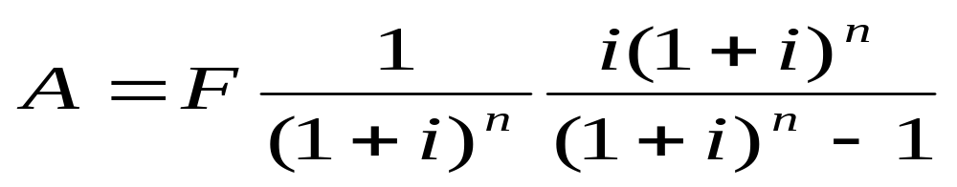
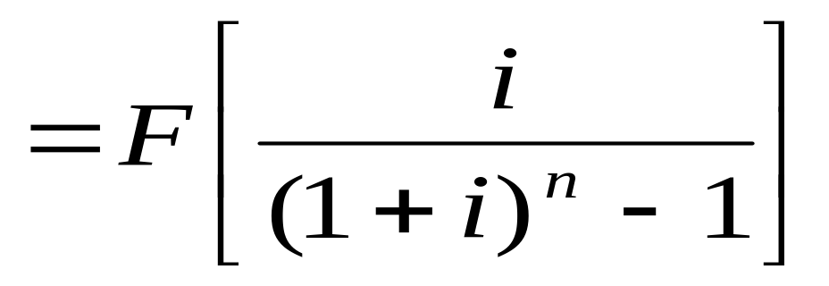
Sinking fund factor and Uniform-series compound-amount factor (A/F and F/A)
The simplest way to derive the formulas is to substitute into those already developed. Thus, if P from equation for P/F is substituted into equation for A/P, the following formula results:

Slide 18
Uniform series
The expression in brackets is the sinking fund, or A/F, factor.
It is use to determine the uniform annual worth series that would be equivalent to a given future worth F.
Note that the uniform series A begins at the end of period 1 and continues through the period of the given F.

Slide 19
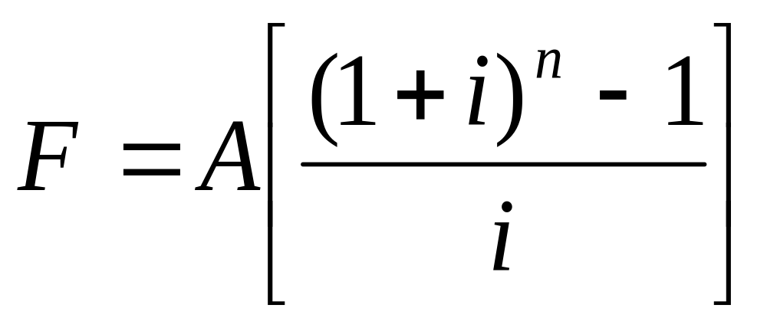
Uniform Series
Rearranging to express F in terms of A, we get the equation below. The term in bracket is the
Uniform Series Compound Amount Factor (USCAF) or F/A factor

Slide 20
F/A factor
The uniform series compound amount factor (USCAF), or F/A factor when multiplied by a given uniform annual amount A, will yield the future worth of the uniform series.
It is important to note that the future amount F occurs in the same period as the last A.

Slide 21
Standard Factor notation and the use of interest tables
A standard notation has been adopted which includes the interest rate and the number of periods and is always in the general form:
(X/Y, i, n)
X represents what is to be found
Y represents what is given
i is the interest rate in percent
n is the number of periods involved

Slide 22
Standard Factor notation and the use of interest tables
(F/P, 6%, 20)
means obtain the factor which when multiplied by a given P allows you to find the future amount of money F that will be accumulated in 20 periods if the interest rate is 6% per period.

Slide 23
Standard Factor notation and the use of interest tables
Factor Name and Standard Notation
Single payment present-worth (SPPWF) or the P/F (P/F, i, n)
Single payment compound amount (SPCAF) or the F/P (F/P, i, n)
Uniform-series present-worth (USPWF), or P/A.(P/A, i, n)
Capital recovery factor (CRF), or the A/P(A/P, i, n)
Sinking fund, or A/F(A/F, i, n)
Uniform series compound amount (USCAF), or F/A(F/A, i, n)

Slide 24
Interpolation in interest tables
Sometimes it is necessary to locate a factor value for an interest rate i or number of periods n that is not in the interest tables. When this situation occurs, the desired factor value can be obtained in one of two ways:
By using the formulas derived or
By interpolating between the tabulated values

Slide 25
Interpolation in interest tables
When the formula is applied, the factor value is accurate since the specific values of I and n are used. However it is possible to make mistakes since the formulas are similar to each other, especially with uniform series.
Additionally, the formulas become more complex when gradients are introduced.

Slide 26
Interpolation in interest tables
Linear interpolation for an untabulated interest rate I or number of periods n takes more time to complete than using the formula.
Also interpolation introduces some level of inaccuracy depending on the distance between the two boundary values selected for i or n, as the formulas themselves are non-linear functions.

